Slide 1
AVL Trees
EECS 233

Slide 2
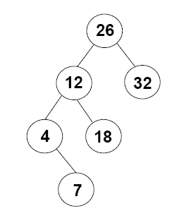
Height and Balance of Trees
The height of a tree is the length of the longest path from the root node to a leaf node.
  What is the height of the tree with root=12?
  The height of a tree with only one node (a leaf)? (0)
  Empty tree? (-1)
balance of a tree (with node N as the root): balance(N) = height(N's right subtree) – height(N's left subtree)
  balance(node 26) = 0 – 2 = –2
  Balance(node 4) = 0 – (–1) = 1

Slide 3
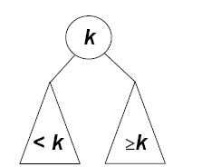
AVL Trees
(Adelson-Velsky & Landis’62)
An AVL tree is a variant of a binary search tree that takes special measures to ensure that the tree is balanced.
  Binary search tree
  Balanced: balance of all nodes are -1, 0, or 1
If a newly inserted node would cause the tree to go out of balance, the nodes are rearranged to restore balance.
Challenge: the steps taken to restore balance must:
  maintain the search-tree inequalities
  have a worst-case time complexity of O(log n)
≤ k

Slide 4
AVL Trees: Leafs’ Depth
An AVL tree is a variant of a binary search tree that takes special measures to ensure that the tree is balanced.
  Binary search tree
  Balanced: balance of all nodes are -1, 0, or 1
≤ k
D
F
E
h=7
G
h=5
B
L
Leaf depths may vary!
A
K
H
C
M
D
N
T

Slide 5
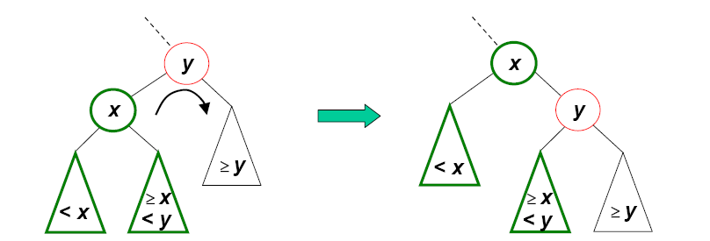
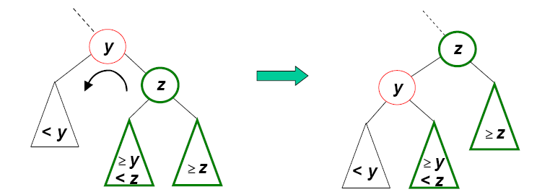
Rotation Operations
A rotation rearranges the nodes in a tree while maintaining the search-tree inequalities.
  Right rotation on (around) y:
  Left rotation on y:
≤
≤
≤
≤
≤
≤
≤
≤

Slide 6
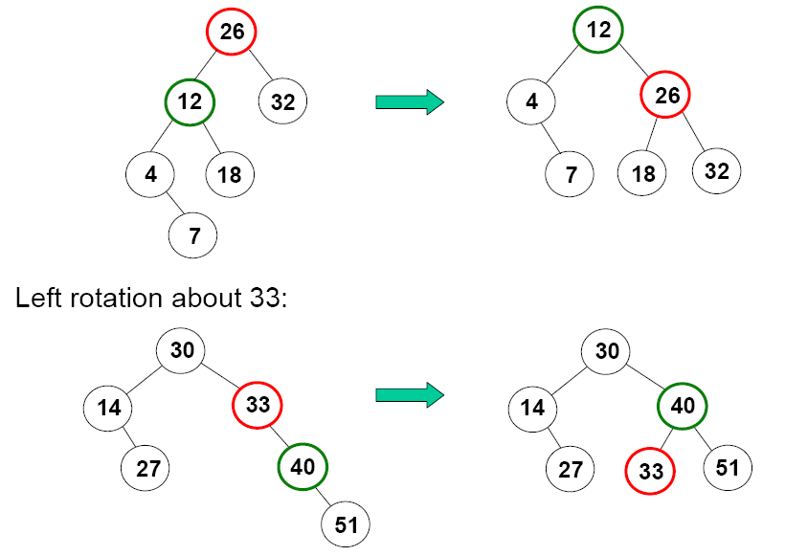
Example Rotations
Right rotation on node 26
Left rotation on node 33

Slide 7
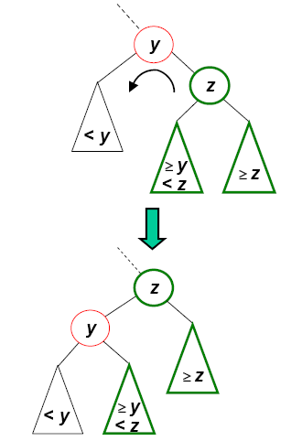
Implementation of Rotations
AVL Tree Representation in Java
  public class AVLTree {
    private class Node {
      private int key;
      private String data;
      private Node left; // reference to left child
      private Node right; // reference to right child
      private Node parent; // reference to parent node
      private int balance; // balance value of the node
      …
    }
    private Node root;
    …
  }
assume each node has a reference to its parent, i.e., define left, right, and parent references in each node
≤
≤
≤
≤

Slide 8
Implementation of Rotations
A rotation involves just rearranging references.
Example: a left rotation.
  private void LeftRotation(Node y)
  {
    ?
  }
Involves changing child/parent variables:
right child of parent of y
right child and parent of y,
left child and parent of z,
parent of left child of z
Constant-time complexity!

Slide 9
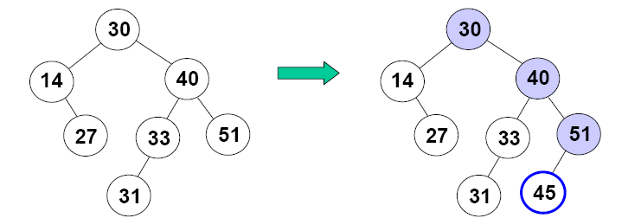
Insertion into AVL Trees
Remember two new fields:
  a reference to the node's parent (null for the root)
  the node's balance (an integer)
We begin by inserting the node as in a binary search tree.
An insertion can only affect the height values and balance values in the new node's ancestors.

Slide 10
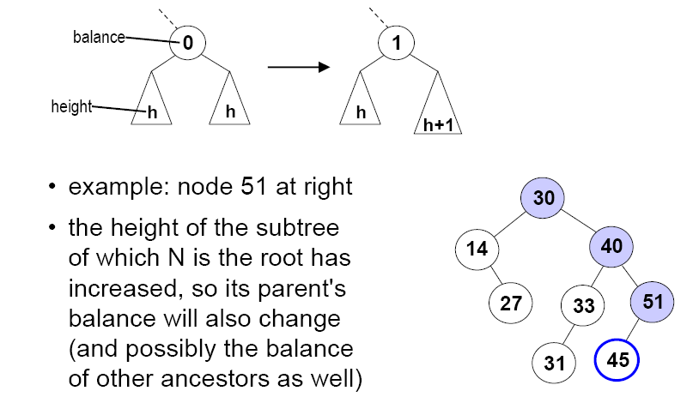
Change in Balance: Case 1
When an insertion causes the subtree of node N to increase in height, there are three cases
Case 1: N's balance goes from 0 to +/–1.
N
N
Example: node 51
Node N’s subtree is still within AVL rules
The height of N has increased
So the balance of N’s parent will change
Need to check if N’s parent satisfies the
AVL rule.
The balance of other ancestors may also
be affected
N
Notes:
How do we maintain the balance variable? Say, node X is inserted. The "insert" method needs to go from X to its parent and update parent’s balance. So you have a “private boolean updateBalanceAfterInsert(Node child)” method on an AVL node where “child” is the child node leading up to the current node. Whenever it is invoked on a node Y, the node Y knows from the “child” argument that this call is from the left child or right child. And Y also knows that whichever child it is coming from, this child has increased its subtree height by 1. So, Y can update its balance variable accordingly, perform a rotation if needed, and return from the updateBalanceAfterInsert execution “true” if Y's balance change indicates that the overall height of Y has increased or stayed the same. Based on this result, the “insert” method will invoke updateBalanceAfterInsert on Y’s parent (if any - Y may be the root).

Slide 11
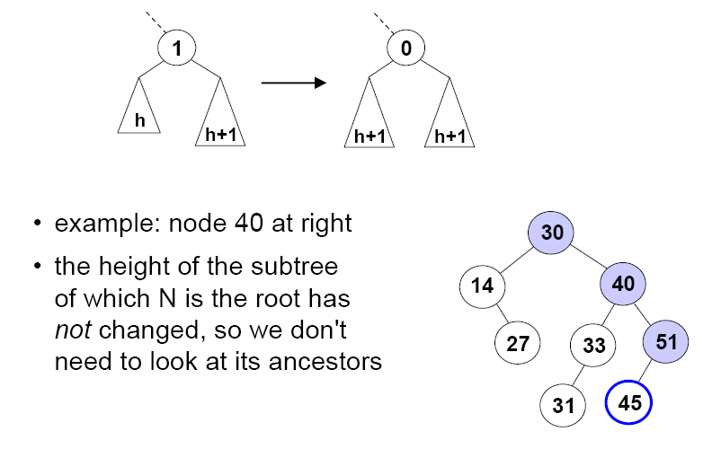
Change in Balance: Case 2
Case 2: N's balance goes from +/–1 to 0.
Example: node 40 at right
The height of the subtree
of which N is the root has
not changed, so we don't
need to look at its ancestors

Slide 12
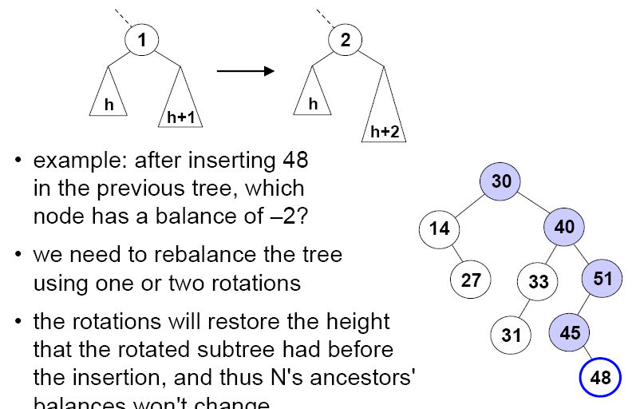
Change in Balance: Case 3
Case 3. N's balance goes from 1 to 2 or from -1 to -2.
Example: after inserting 48 in the previous tree, node 51 has a balance of –2
We need to rebalance the tree using rotations
A good thing: the rotations will restore the height that the rotated subtree had before the insertion, and thus N's ancestors‘ balances won't change.

Slide 13
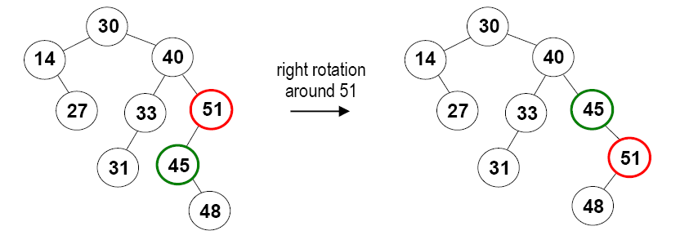
A Puzzle?
A single rotation doesn't always rebalance the tree.

Slide 14
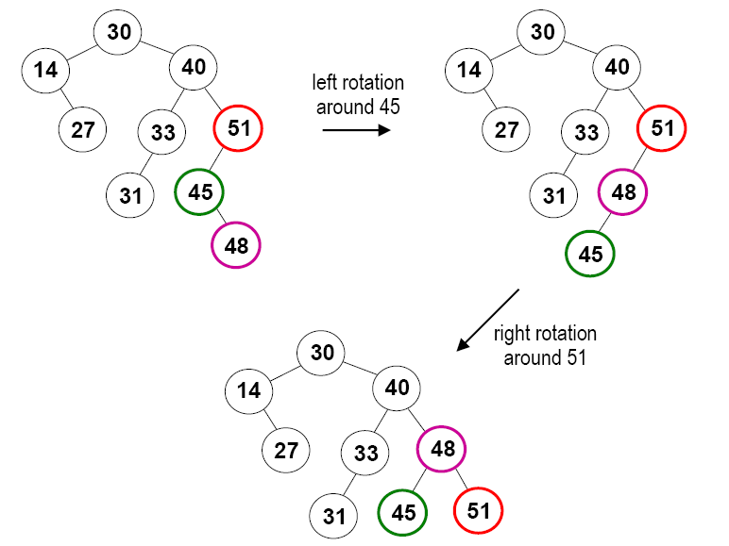
Double Rotations
Instead, we perform two rotations (a double rotation):

Slide 15
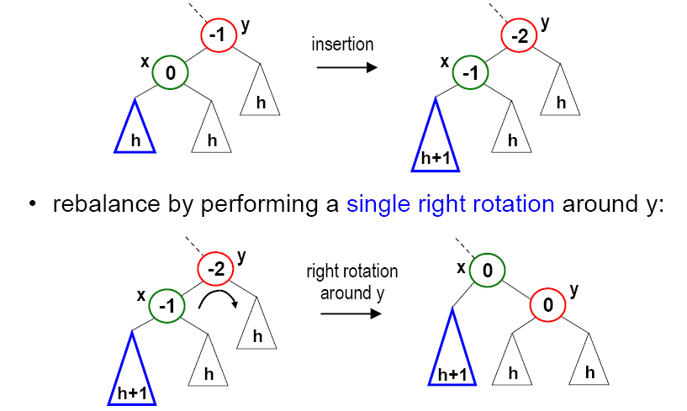
Rebalance an AVL Tree (1)
Case 3a: we've added a node to the left subtree of y's left child, x, bringing y's balance to -2.
  rebalance by performing a single right rotation around y:

Slide 16
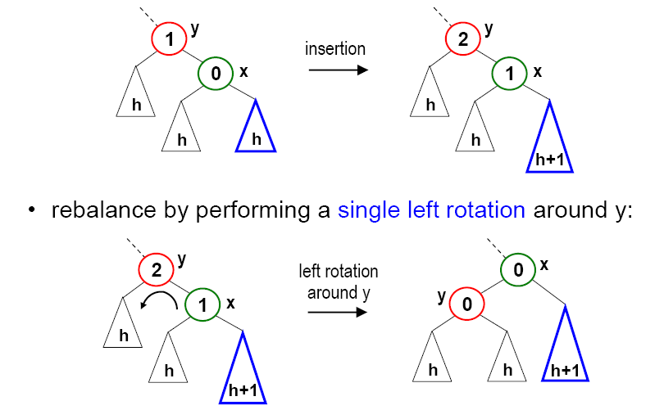
Rebalance an AVL Tree (2)
Case 3b: we've added a node to the right subtree of y's right child, x, bringing y's balance to +2. (symmetric to case 3a)
  rebalance by performing a single left rotation around y:

Slide 17
Rebalance an AVL Tree (3)
Case 3c: we've added a node to the right subtree of y's left child, x, bringing y's balance to -2.
  Single rotation does not help
y
y
x
-1
-2
2
x
x
y
0
1
-1
h
h
h
h
h
h
h
h+1
h+1

Slide 18
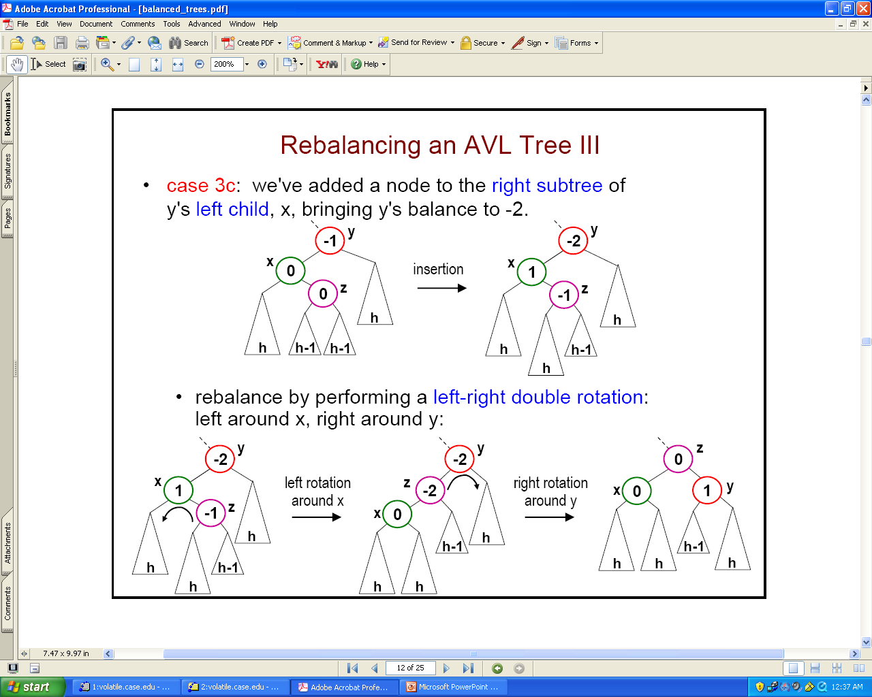
Rebalance an AVL Tree (3)
Case 3c: we've added a node to the right subtree of y's left child, x, bringing y's balance to -2.
  rebalance by performing a left-right double rotation: left around x, right around y:

Slide 19
Rebalance an AVL Tree (4)
Case 3d: we've added a node to the left subtree of y's right child, x, bringing y's balance to +2. (symmetric to case 3c; can you draw pictures to show how it works?)
  rebalance by performing a right-left double rotation: right around x, left around y
y
1
y
2
x
x
0
-1
h
h
h
h
h
h+1

Slide 20
Implementation of Double Rotations
  private void leftRightRotation(Node y)
  {
    leftRotation(y.left);
    rightRotation(y);
  }

Slide 21
Complete Insertion Method
Insert the new node N as in a binary search tree.
Use parent references to follow the path from N back to the root:
  if an ancestor's balance was 0, it will now be +/–1 (case 1), continue up the path to the root
  if an ancestor's balance was +/–1, we have two cases:
    it is now 0 (case 2): stop
    it is now +/–2, and we need to perform 1 or 2 rotations to rebalance the tree (cases 3a – 3d), depending on where N is inserted (left-left, right-right, left-right, right-left).
    in either case, stop (no need to go any further up the tree)

Slide 22
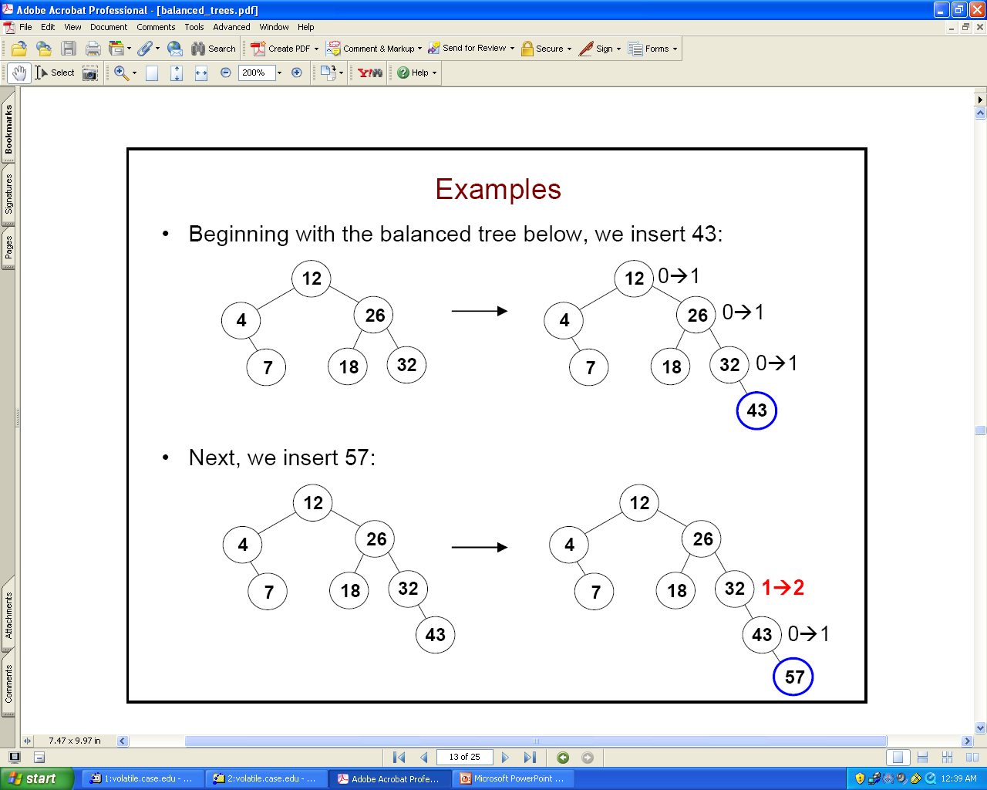
Examples of Insertion
Insert: 43 – 57 – 35

Slide 23
Examples of Insertion
Insert 43. No balancing is required
Insert 57

Slide 24
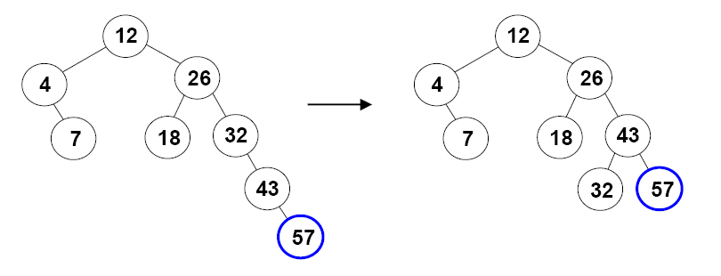
Examples of Insertion
32's balance is too big. Since we added a node to the right subtree of its right child, this is case 3b.
  we rebalance using a single left rotation about 32:
  we don't need to go further up the tree (the balances of 26 and 12 are unchanged)

Slide 25
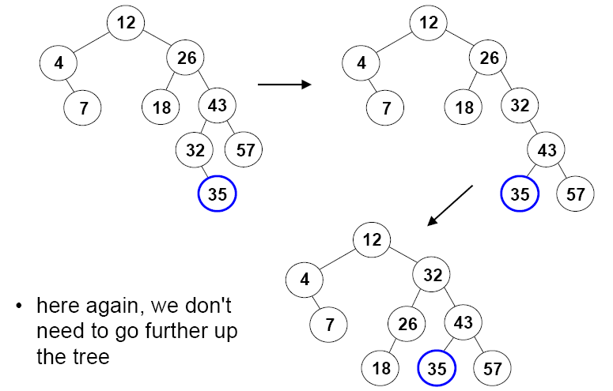
Examples of Insertion
Insert 35
Node 26's balance is too big. What case is this?
We rebalance using a right-left double rotation.

Slide 26
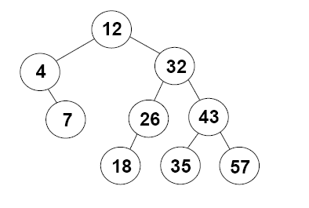
An Exercise
Insert 15, 13, 14

